Slide 1
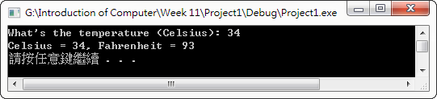

Homework 1 (Function is needed for both of the homework)
Convert Celsius to Fahrenheit
int tempC2F(int);
HINT : $°F=\frac{9}{5}×°C+32$

Slide 2
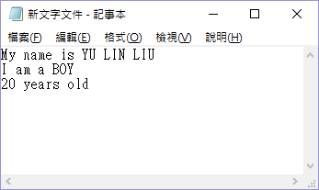
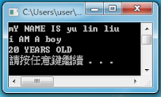
Homework 2 (Function is needed for both of the homework)
Create a txt document that context is self-introduction in English. The format is as picture on the below, the upper case and lower case should be same as text in the picture.
Read the txt file and convert its upper case to lower case and convert lower case to upper case as well. Then print the result.
void transfer(void);
Name should be Romanization with upper case.
Gender use BOY/GIRL.
Age use Arabic numerals.
Type directly on the txt file.

Slide 3
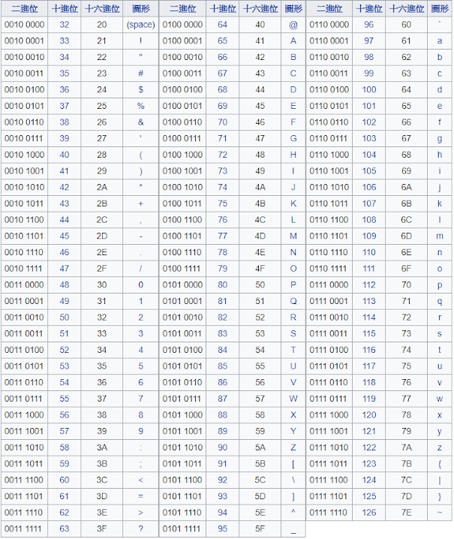
ASCII

Slide 4
Upload file
studentID_hw_07.zip
studentID_hw_01.cpp
studentID_hw_02.cpp
self_introduction.txt

